Slide 1
Chapter 2
Bits, Data Types, and Operations

Slide 2

Computer is a “binary” “digital” system.
Digital system:
  finite number of symbols
Binary (base two) system:
  has two states: 0 and 1
Basic unit of information is the binary digit, or bit.
Values with more than two states require multiple bits.
  A collection of two bits has four possible states:
  00, 01, 10, 11
  A collection of three bits has eight possible states:
  000, 001, 010, 011, 100, 101, 110, 111
  A collection of n bits has 2^{n} possible states.
2-<number>

Slide 3
What kinds of data do we need to manipulate?
  Instructions – operations performed by computer
  Numbers – integers, floating point,
  complex, rational, irrational, …
  Logical – true, false
  Text – characters, strings, …
  Images – pixels, colors, shapes, …
  Sound
  …
2-<number>

Slide 4
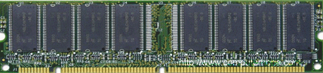
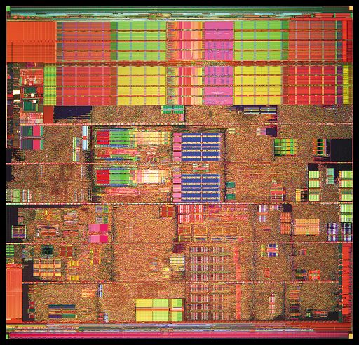
Beauty is in the eyes of beholder…
CPU (Processor)
address
data
0000000000000000
1011010001010101
0000000000000001
1011011101011111
0000000000000010
0110101001010100
0000000000000011
1010001101010101
Memory
0000000000000100
1111101110110101
……
……..
……
……..
1111111111111110
1011101110110101
1111111111111111
0001101110110101
PC (Program Counter)
  PC contains the address of the next instruction to be “executed”
  The execution of an instruction determines the next PC value
  An instruction may access data in memory during its execution
Source: http://www.computerhope.com/pictures/memory/512dimm.gif
http://techreport.com/r.x/p4-prescott/die-shot.jpg
2-<number>

Slide 5
Unsigned Integers
Non-positional notation
  could represent a number (“5”) with a string of ones (“11111”)
    Unary system
  problems?
Weighted positional notation
  like decimal numbers: “329”
  “3” is worth 300, because of its position, while “9” is only worth 9
most
significant
least
significant
329
101
10²
10¹
10⁰
2²
2¹
2⁰
3x100 + 2x10 + 9x1 = 329
1x4 + 0x2 + 1x1 = 5
2-<number>

Slide 6
Unsigned Integers (cont.)
An n-bit unsigned integer represents 2^{n} values:
from 0 to 2^{n}-1.
2² | 2¹ | 2⁰
0 | 0 | 0 | 0
0 | 0 | 1 | 1
0 | 1 | 0 | 2
0 | 1 | 1 | 3
1 | 0 | 0 | 4
1 | 0 | 1 | 5
1 | 1 | 0 | 6
1 | 1 | 1 | 7
2-<number>

Slide 7
Unsigned Binary Arithmetic
Base-2 addition – just like base-10!
  add from right to left, propagating carry
carry
10010 10010 1111
+ 1001 + 1011 + 1
11011 11101 10000
10111
+ 111
Subtraction, multiplication, division,…
2-<number>

Slide 8
Signed Integers
With n bits, we have 2^{n} distinct values.
  assign about half to positive integers (1 through 2^{n-1})
  and about half to negative (- 2^{n-1} through -1)
  that leaves two values: one for 0, and one extra
Positive integers
  just like unsigned – zero in most significant (MS) bit
  00101 = 5
Negative integers
  sign-magnitude – set MS bit to show negative,
  other bits are the same as unsigned
  10101 = -5
  one’s complement – flip every bit to represent negative
  11010 = -5
  in either case, MS bit indicates sign: 0=positive, 1=negative
2-<number>

Slide 9
Two’s Complement
Problems with sign-magnitude and 1’s complement
  two representations of zero (+0 and –0)
  arithmetic circuits are complex
    How to add two sign-magnitude numbers?
      e.g., try 2 + (-3)
    How to add to one’s complement numbers?
      e.g., try 4 + (-3)
Two’s complement representation developed to make
circuits easy for arithmetic.
  for each positive number (X), assign value to its negative (-X),
  such that X + (-X) = 0 with “normal” addition, ignoring carry out
00101 (5) 01001 (9)
+ 11011 (-5) + (-9)
00000 (0) 00000 (0)
2-<number>

Slide 10
Two’s Complement Representation
If number is positive or zero,
  normal binary representation, zeroes in upper bit(s)
If number is negative,
  start with positive number
  flip every bit (i.e., take the one’s complement)
  then add one
00101 (5) 01001 (9)
11010 (1’s comp) (1’s comp)
+ 1 + 1
11011 (-5) (-9)
2-<number>

Slide 11
Two’s Complement Signed Integers
MS bit is sign bit – it has weight –2^{n-1}.
Range of an n-bit number: -2^{n-1} through 2^{n-1} – 1.
  The most negative number (-2^{n-1}) has no positive counterpart.
-2³ | 2² | 2¹ | 2⁰
0 | 0 | 0 | 0 | 0
0 | 0 | 0 | 1 | 1
0 | 0 | 1 | 0 | 2
0 | 0 | 1 | 1 | 3
0 | 1 | 0 | 0 | 4
0 | 1 | 0 | 1 | 5
0 | 1 | 1 | 0 | 6
0 | 1 | 1 | 1 | 7
-2³ | 2² | 2¹ | 2⁰
1 | 0 | 0 | 0 | -8
1 | 0 | 0 | 1 | -7
1 | 0 | 1 | 0 | -6
1 | 0 | 1 | 1 | -5
1 | 1 | 0 | 0 | -4
1 | 1 | 0 | 1 | -3
1 | 1 | 1 | 0 | -2
1 | 1 | 1 | 1 | -1
2-<number>

Slide 12
Converting Binary (2’s C) to Decimal
If leading bit is one, take two’s complement to get a positive number.
Add powers of 2 that have “1” in the
corresponding bit positions.
If original number was negative,
add a minus sign.
n | 2^{n}
0 | 1
1 | 2
2 | 4
3 | 8
4 | 16
5 | 32
6 | 64
7 | 128
8 | 256
9 | 512
10 | 1024
X = 01101000_{two}
= 2⁶+2⁵+2³ = 64+32+8
= 104_{ten}
Assuming 8-bit 2’s complement numbers.
2-<number>

Slide 13
More Examples
X = 00100111_{two}
= 2⁵+2²+2¹+2⁰ = 32+4+2+1
= 39_{ten}
n | 2^{n}
0 | 1
1 | 2
2 | 4
3 | 8
4 | 16
5 | 32
6 | 64
7 | 128
8 | 256
9 | 512
10 | 1024
X = 11100110_{two}
-X = 00011010
= 2⁴+2³+2¹ = 16+8+2
= 26_{ten}
X = -26_{ten}
Assuming 8-bit 2’s complement numbers.
2-<number>

Slide 14
Converting Decimal to Binary (2’s C)
First Method: Division
Find magnitude of decimal number. (Always positive.)
Divide by two – remainder is least significant bit.
Keep dividing by two until answer is zero,
writing remainders from right to left.
Append a zero as the MS bit;
if original number was negative, take two’s complement.
X = 104_{ten} 104/2 = 52 r0 bit 0
52/2 = 26 r0 bit 1
26/2 = 13 r0 bit 2
13/2 = 6 r1 bit 3
6/2 = 3 r0 bit 4
3/2 = 1 r1 bit 5
X = 01101000_{two} 1/2 = 0 r1 bit 6
2-<number>

Slide 15
Converting Decimal to Binary (2’s C)
n | 2^{n}
0 | 1
1 | 2
2 | 4
3 | 8
4 | 16
5 | 32
6 | 64
7 | 128
8 | 256
9 | 512
10 | 1024
Second Method: Subtract Powers of Two
Find magnitude of decimal number.
Subtract largest power of two
less than or equal to number.
Put a one in the corresponding bit position.
Keep subtracting until result is zero.
Append a zero as MS bit;
if original was negative, take two’s complement.
X = 104_{ten} 104 - 64 = 40 bit 6
40 - 32 = 8 bit 5
8 - 8 = 0 bit 3
X = 01101000_{two}
2-<number>

Slide 16
Operations: Arithmetic and Logical
Recall:
a data type includes representation and operations.
We now have a good representation for signed integers,
so let’s look at some arithmetic operations:
  Addition
  Subtraction
  Sign Extension
We’ll also look at overflow conditions for addition.
Multiplication, division, etc., can be built from these
basic operations.
Logical operations are also useful:
  AND
  OR
  NOT
2-<number>

Slide 17
Addition
As we’ve discussed, 2’s comp. addition is just
binary addition.
  assume all integers have the same number of bits
  ignore carry out
  for now, assume that sum fits in n-bit 2’s comp. representation
01101000 (104) 11110110 (-10)
+ 11110000 (-16) + (-9)
01011000 (98) (-19)
Assuming 8-bit 2’s complement numbers.
2-<number>

Slide 18
Subtraction
Negate subtrahend (2nd no.) and add.
  assume all integers have the same number of bits
  ignore carry out
  for now, assume that difference fits in n-bit 2’s comp. representation
01101000 (104) 11110110 (-10)
- 00010000 (16) - (-9)
01101000 (104) 11110110 (-10)
+ 11110000 (-16) + (9)
01011000 (88) (-1)
Assuming 8-bit 2’s complement numbers.
2-<number>

Slide 19
Sign Extension
To add two numbers, we must represent them
with the same number of bits.
If we just pad with zeroes on the left:
Instead, replicate the MS bit -- the sign bit:
4-bit 8-bit
0100 (4) 00000100 (still 4)
1100 (-4) 00001100 (12, not -4)
4-bit 8-bit
0100 (4) 00000100 (still 4)
1100 (-4) 11111100 (still -4)
2-<number>

Slide 20
Overflow
If operands are too big, then sum cannot be represented as an n-bit 2’s comp number.
We have overflow if:
  signs of both operands are the same, and
  sign of sum is different.
Another test -- easy for hardware:
  carry into MS bit does not equal carry out
01000 (8) 11000 (-8)
+ 01001 (9) + 10111 (-9)
10001 (-15) 01111 (+15)
2-<number>

Slide 21
Logical Operations
Operations on logical TRUE or FALSE
  two states -- takes one bit to represent: TRUE=1, FALSE=0
View n-bit number as a collection of n logical values
  operation applied to each bit independently
A | B | A AND B
0 | 0 | 0
0 | 1 | 0
1 | 0 | 0
1 | 1 | 1
A | B | A OR B
0 | 0 | 0
0 | 1 | 1
1 | 0 | 1
1 | 1 | 1
A | NOT A
0 | 1
1 | 0
2-<number>

Slide 22
Examples of Logical Operations
AND
  useful for clearing bits
    AND with zero = 0
    AND with one = no change
OR
  useful for setting bits
    OR with zero = no change
    OR with one = 1
NOT
  unary operation -- one argument
  flips every bit
11000101
AND 00001111
00000101
11000101
OR 00001111
11001111
NOT 11000101
00111010
2-<number>

Slide 23
Hexadecimal Notation
It is often convenient to write binary (base-2) numbers
as hexadecimal (base-16) numbers instead.
  fewer digits -- four bits per hex digit
  less error prone -- easy to corrupt long string of 1’s and 0’s
Binary | Hex | Decimal
0000 | 0 | 0
0001 | 1 | 1
0010 | 2 | 2
0011 | 3 | 3
0100 | 4 | 4
0101 | 5 | 5
0110 | 6 | 6
0111 | 7 | 7
Binary | Hex | Decimal
1000 | 8 | 8
1001 | 9 | 9
1010 | A | 10
1011 | B | 11
1100 | C | 12
1101 | D | 13
1110 | E | 14
1111 | F | 15
2-<number>

Slide 24
Converting from Binary to Hexadecimal
Every four bits is a hex digit.
  start grouping from right-hand side
011101010001111010011010111
3
A
8
F
4
D
7
This is not a new machine representation,
just a convenient way to write the number.
2-<number>

Slide 25
Fractions: Fixed-Point
How can we represent fractions?
  Use a “binary point” to separate positive
  from negative powers of two -- just like “decimal point.”
  2’s comp addition and subtraction still work.
    if binary points are aligned
2⁻¹ = 0.5
2⁻² = 0.25
2⁻³ = 0.125
00101000.101 (40.625)
+ 11111110.110 (-1.25)
00100111.011 (39.375)
No new operations -- same as integer arithmetic.
2-<number>

Slide 26
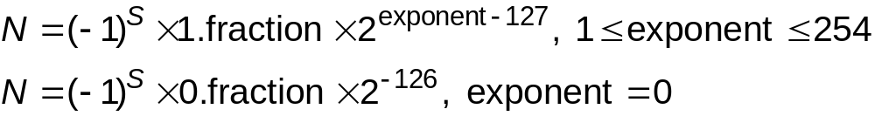
Very Large and Very Small: Floating-Point
Large values: 6.023 x 10²³ -- requires 79 bits
Small values: 6.626 x 10⁻³⁴ -- requires >110 bits
Use equivalent of “scientific notation”: F x 2E
Need to represent F (fraction), E (exponent), and sign.
IEEE 754 Floating-Point Standard (32-bits):
1b
8b
23b
S
Exponent
Fraction
2-<number>
Notes:
Exponent = 255 used for special values:
If Fraction is non-zero, NaN (not a number).
If Fraction is zero and sign is 0, positive infinity.
If Fraction is zero and sign is 1, negative infinity.

Slide 27
Floating Point Example
Single-precision IEEE floating point number:
10111111010000000000000000000000
  Sign is 1 – number is negative.
  Exponent field is 01111110 = 126 (decimal).
  Fraction is 0.100000000000… = 0.5 (decimal).
Value = -1.5 x 2⁽¹²⁶⁻¹²⁷⁾ = -1.5 x 2⁻¹ = -0.75.
sign
exponent
fraction
2-<number>

Slide 28
Floating-Point Operations
Will regular 2’s complement arithmetic work for
Floating Point numbers?
(Hint: In decimal, how do we compute 3.07 x 10¹² + 9.11 x 10⁸?)
2-<number>

Slide 29
Text: ASCII Characters
ASCII: Maps 128 characters to 7-bit code.
  both printable and non-printable (ESC, DEL, …) characters
00 | nul | 10 | dle | 20 | sp | 30 | 0 | 40 | @ | 50 | P | 60 | ` | 70 | p
01 | soh | 11 | dc1 | 21 | ! | 31 | 1 | 41 | A | 51 | Q | 61 | a | 71 | q
02 | stx | 12 | dc2 | 22 | " | 32 | 2 | 42 | B | 52 | R | 62 | b | 72 | r
03 | etx | 13 | dc3 | 23 | # | 33 | 3 | 43 | C | 53 | S | 63 | c | 73 | s
04 | eot | 14 | dc4 | 24 | $ | 34 | 4 | 44 | D | 54 | T | 64 | d | 74 | t
05 | enq | 15 | nak | 25 | % | 35 | 5 | 45 | E | 55 | U | 65 | e | 75 | u
06 | ack | 16 | syn | 26 | & | 36 | 6 | 46 | F | 56 | V | 66 | f | 76 | v
07 | bel | 17 | etb | 27 | ' | 37 | 7 | 47 | G | 57 | W | 67 | g | 77 | w
08 | bs | 18 | can | 28 | ( | 38 | 8 | 48 | H | 58 | X | 68 | h | 78 | x
09 | ht | 19 | em | 29 | ) | 39 | 9 | 49 | I | 59 | Y | 69 | i | 79 | y
0a | nl | 1a | sub | 2a | * | 3a | : | 4a | J | 5a | Z | 6a | j | 7a | z
0b | vt | 1b | esc | 2b | + | 3b | ; | 4b | K | 5b | [ | 6b | k | 7b | {
0c | np | 1c | fs | 2c | , | 3c | < | 4c | L | 5c | \ | 6c | l | 7c | |
0d | cr | 1d | gs | 2d | - | 3d | = | 4d | M | 5d | ] | 6d | m | 7d | }
0e | so | 1e | rs | 2e | . | 3e | > | 4e | N | 5e | ^ | 6e | n | 7e | ~
0f | si | 1f | us | 2f | / | 3f | ? | 4f | O | 5f | _ | 6f | o | 7f | del
2-<number>

Slide 30
Interesting Properties of ASCII Code
What is relationship between a decimal digit ('0', '1', …)
and its ASCII code?
What is the difference between an upper-case letter
('A', 'B', …) and its lower-case equivalent ('a', 'b', …)?
Given two ASCII characters, how do we tell which comes first in alphabetical order?
Are 128 characters enough?
(http://www.unicode.org/) 16bits representation
(한글 U+AC00~U+D7A3 가나다순으로 11,172자)
No new operations -- integer arithmetic and logic.
2-<number>

Slide 31
Other Data Types
Text strings
  sequence of characters, terminated with NULL (0)
  typically, no hardware support
Image
  array of pixels
    monochrome: one bit (1/0 = black/white)
    color: red, green, blue (RGB) components (e.g., 8 bits each)
  hardware support:
    typically none, in general-purpose processors
    MMX -- multiple 8-bit operations on 32-bit word
Sound
  sequence of fixed-point numbers
2-<number>

Slide 32
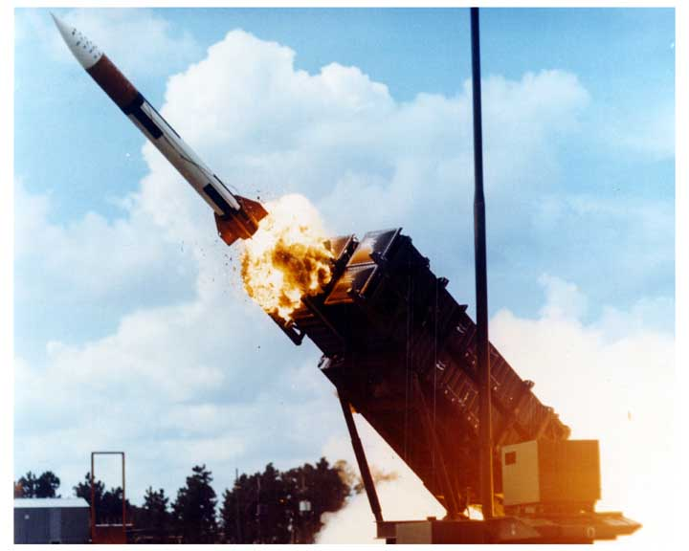
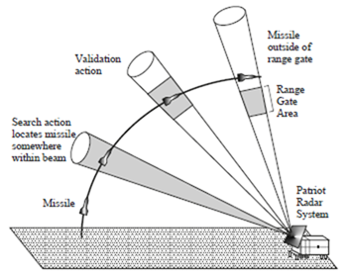
Software Bug - Real World Example
Patriot Missile Failure on February 25, 1991
  Patriot Missile failed to track and intercept an incoming Iraqi Scud missile killing 28 soldiers and injuring 100 other people
  Due to a software bug
    Internal system clock was multiplied by 1/10 to produce the time in seconds
    1/10 = 0.000110011001100110011001100…but
    the stored value was in 24 bit fixed-point and it was 0.00011001100110011001100
    introduced an error of 0.0000000000000000000000011001100…in binary, or about 0.000000095 in decimal
    After 100 hours of operation the error was 0.000000095 x 100 x 60 x 60 x 10, an amount large enough to miss the target…
Source: http://www-users.math.umn.edu/~arnold/disasters/patriot.html
http://2.bp.blogspot.com/-VoxzUW7nOxc/To3-e2V-8yI/AAAAAAAAATU/BIAxIMken-k/s1600/patriot_02.jpg
http://lh4.ggpht.com/-AbQLxaQQ9z8/VLfLYP0MKLI/AAAAAAABGFA/iQKVpMDxcCM/image_thumb.png?imgmax=800
2-<number>

Slide 33
꼭 기억해야 할 것
메모리의 내용은 단순한 0과 1의 pattern
해석은
  PC에 따라: instructions
  Instruction에 따라
    integers
    bit vectors
    floating point numbers
    characters
  Program 상에서 해석에 따라 / 입출력 장치 (I/O devices) 해석에 따라
    strings
    images
    sounds
    etc.
Software bugs, from something amusing to a nightmare
2-<number>

